Slide 1

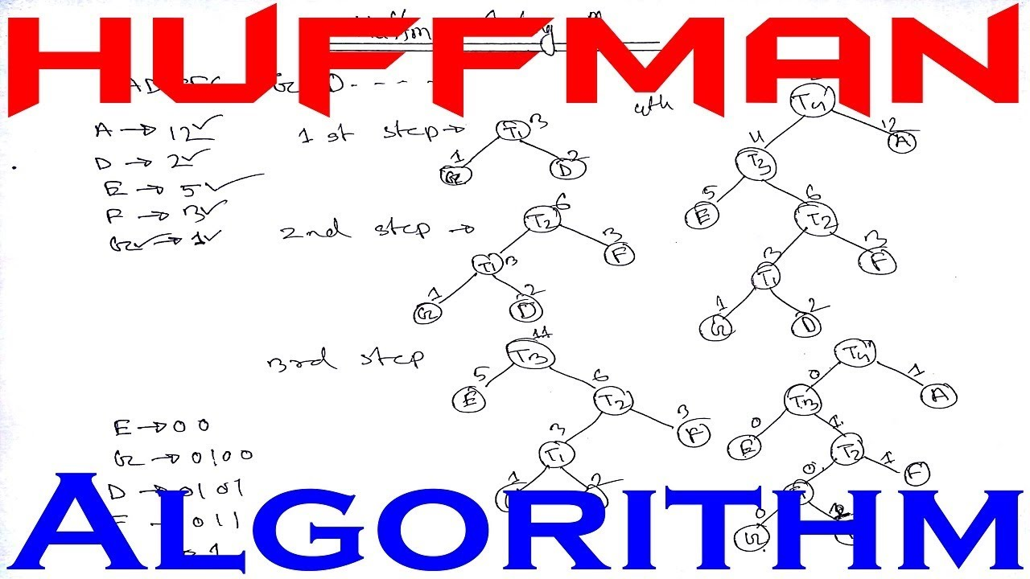

Introduction to Huffman's Algorithm
Huffman's Algorithm is a method for lossless data compression, developed by
David A. Huffman in 1952.
It involves building a binary tree to efficiently encode and decode the input
data, resulting in optimized compression.
by Harsh Sharma

Slide 2

Basics of Binary Encoding
Significance: Binary encoding is the representation of data using only
two symbols 0 and 1.
Bits and Bytes: Information is structured as bits and grouped into bytes
for processing.
Machine Language: Computers understand and process instructions
through binary encoding.

Slide 3
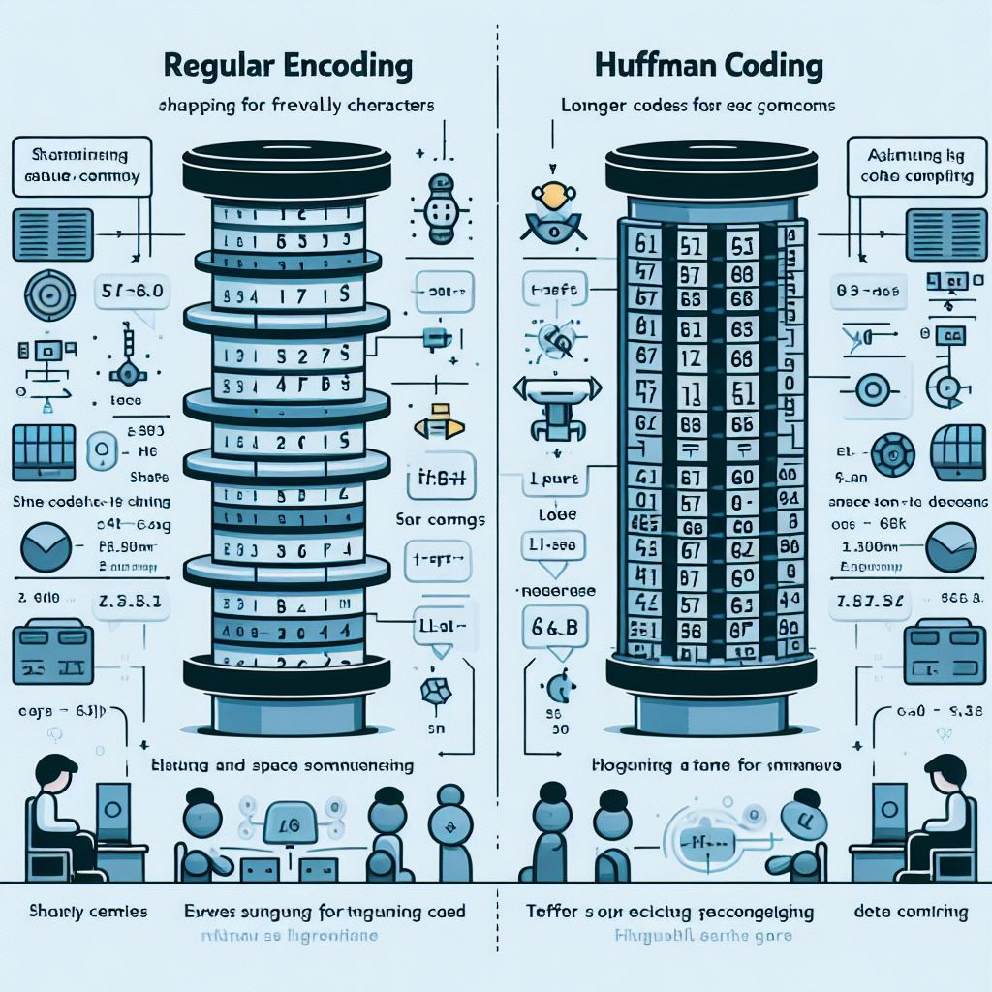
Need for Huffman coding
In data compression, efficient encoding is essential for reducing file sizes.
Huffman coding provides a way to represent data with minimal bits,
enabling significant space savings.

Slide 4
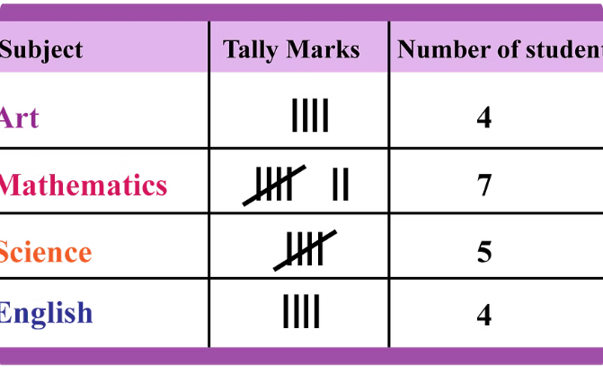
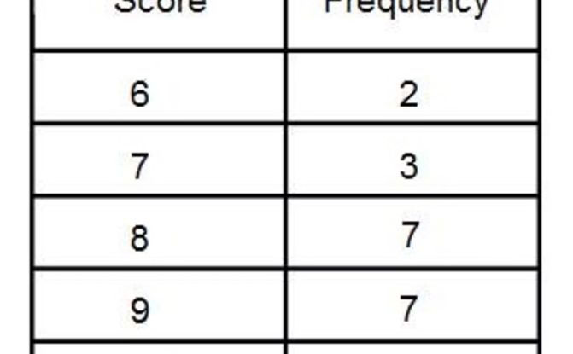
Understanding Frequency Tables
Visual Representation
Data Analysis Tool
A frequency table visually demonstrates the occurrence of each data point, aiding in identifying the most frequent elements.
Frequency tables are essential for statistical analysis, providing insights into the distribution and frequency of data values.

Slide 5
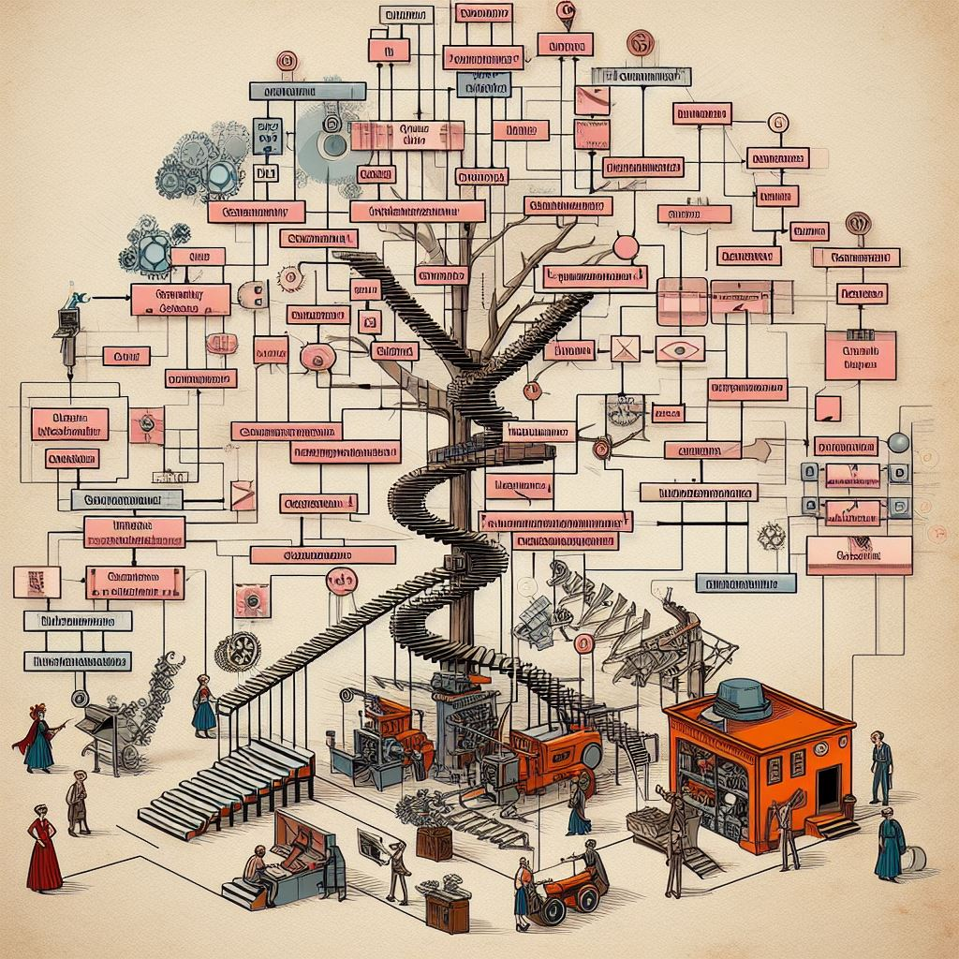
Constructing the Huffman Tree
1
Frequency Analysis
Analyze the frequency of each character in the input text.
2
Priority Queue
Create a priority queue, where the nodes are trees consisting of single nodes with the character and its frequency.
3
Merge Nodes
Merge the two trees with the lowest frequencies to create a new tree with a frequency equal to the sum of the two trees' frequencies.

Slide 6
Assigning Huffman Codes
Optimal Code Length
Dynamic Structure
Huffman codes are assigned based on the frequency of characters, ensuring a shorter code for more frequent characters.
The Huffman tree dynamically adapts to the frequency of characters, ensuring an optimal prefix coding scheme.
This efficient encoding helps in reducing the overall size of the encoded data.
Each character is assigned a unique binary code during the encoding process.

Slide 7
Advantage of Huffman Coding
Efficient Compression
Reduction in File Size
Huffman coding provides an efficient way to compress data by assigning shorter codes to frequently occurring characters.
By using variable-length codes based on the frequency of characters, Huffman coding reduces the overall size of files.
Fast Retrieval
Adaptability
During decoding, the shorter codes result in faster retrieval of data, making it efficient for data transmission.
Huffman coding can adapt to changing data and adjust the code lengths based on the actual frequency of characters.

Slide 8



Real World Application
Data Compression
Network Communication
Text Encoding
Huffman coding is used in data compression algorithms to efficiently reduce the size of files and data transmission.
Huffman coding is utilized in text encoding for efficient representation of characters and symbols.
It is widely implemented in network communication for efficient data transfer and bandwidth optimization.

Slide 9

Limitation of Huffman Coding
One limitation of Huffman coding is that it is not suitable for data that changes frequently.
It also requires the sender and receiver to have the same frequency table to decode the message accurately.
Furthermore, the use of Huffman coding may lead to increased computational complexity in certain scenarios.

Slide 10



Optimal Compression
xxxxxxxxyyy
Conclusion
Optimal Compression
Huffman's algorithm produces the most compact lossless
representation of data.
Efficient Implementation
The algorithm is relatively simple to implement and can be
computed efficiently.
Wide Applications
Huffman coding is widely used in text, image, and audio compression, as well as network transmission.

